Slide 1

PowerCo
Task 4 - Findings & Recommendations

Slide 3
Problem Statement
PowerCo is a major gas and electricity utility that supplies to corporate, SME (Small & Medium Enterprise), and residential customers.
The power-liberalization of the energy market in Europe has led to significant customer churn, especially in the SME segment.
They have partnered with BCG to help diagnose the source of churning SME customers.
A fair hypothesis is that price changes affect customer churn. Therefore, it is helpful to know which customers are more (or less) likely to churn at their current price, for which a good predictive model could be useful.
Moreover, for those customers that are at risk of churning, a discount might incentivize them to stay with our client. The head of the SME division is considering a 20% discount that is considered large enough to dissuade almost anyone from churning (especially those for whom price is the primary concern).
The client plans to use the predictive model on the 1st working day of every month to indicate to which customers the 20% discount should be offered.

Slide 4
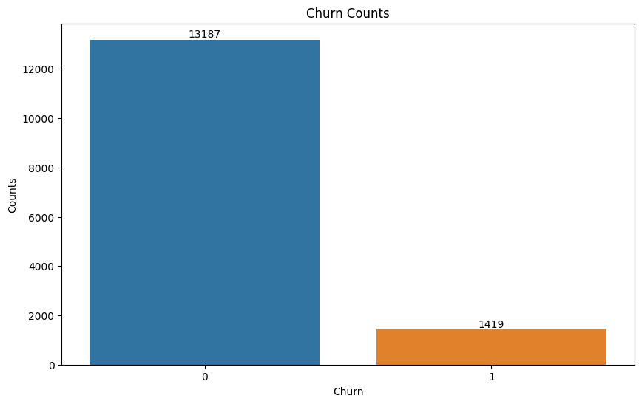
Current Churn Counts
As you can see from the figure on the right side, out of a total 14606 clients 1419 i.e. 9.71% have churned.
Our initial guess is that the other power and gas providers maybe charging less or the quality of power or frequent power outages and other might be the reason for churning.
So, we will be doing the analysis on the data that is provided by PowerCo to arrive at a conclusion.
Based on various EDA we will choose a model to predict the churn.

Slide 5
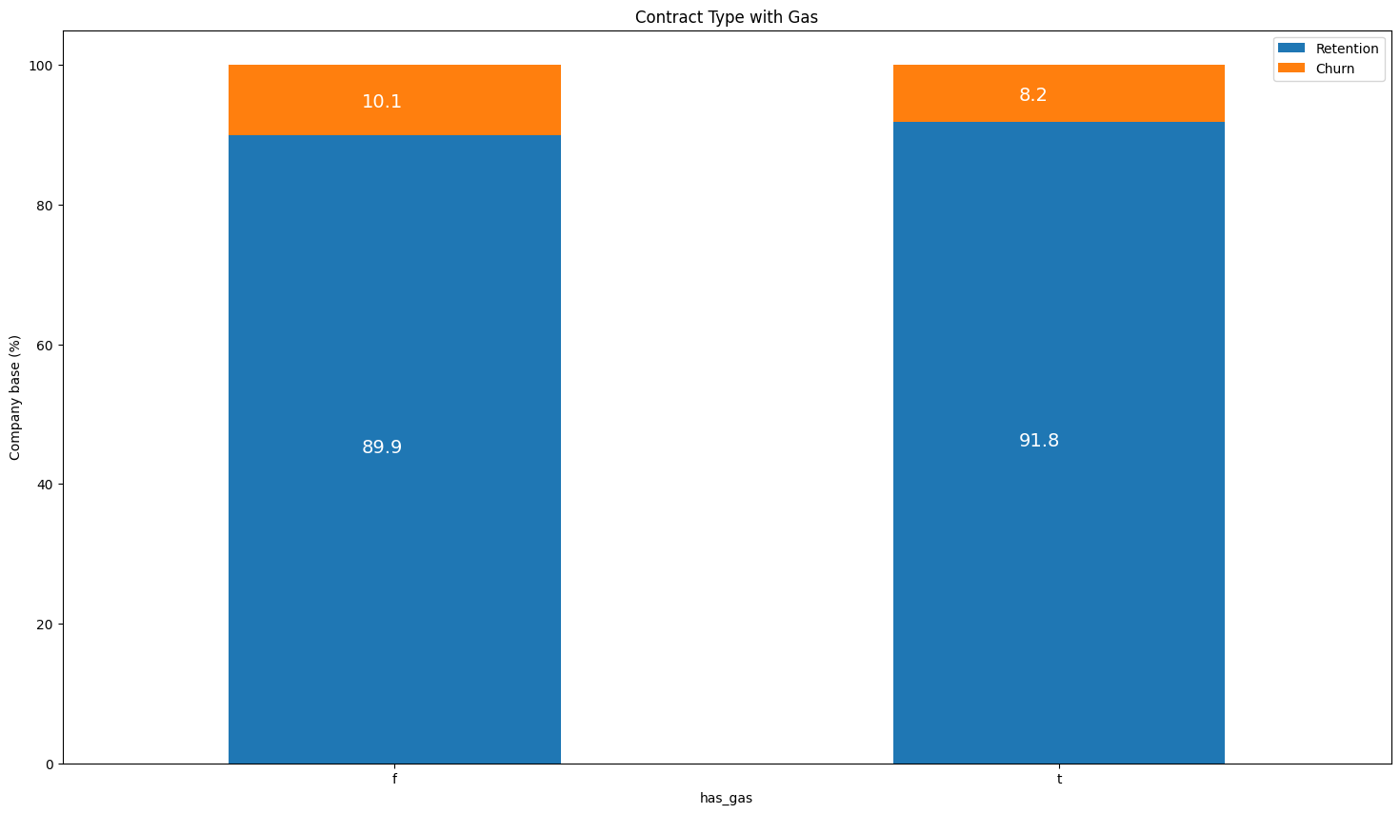
Contract Type with Gas
As you can see from the stacked bar chart, customers who also buy gas from PowerCo have less churn rate 8.2% than the customers who don’t buy gas 10.1%.

Slide 6
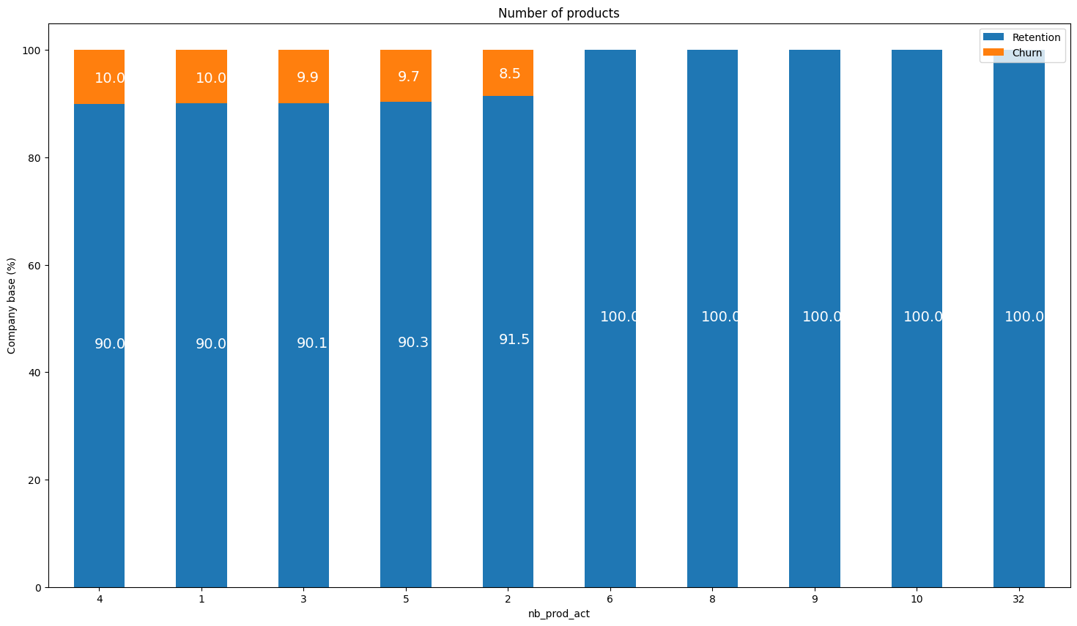
Number of Products

